Slide 1
Furniture Store
MANOJ Kumar Natha
Venkata sai Chaitanya vaddella
Abhitej boorla

Slide 2
Introduction
The project is to create a database for a furniture store.
This database has functionalities to store details of:
Customers, Employees, Products
Stock of the products
The orders placed by the customers as well as by the furniture store from manufacturers.

Slide 3
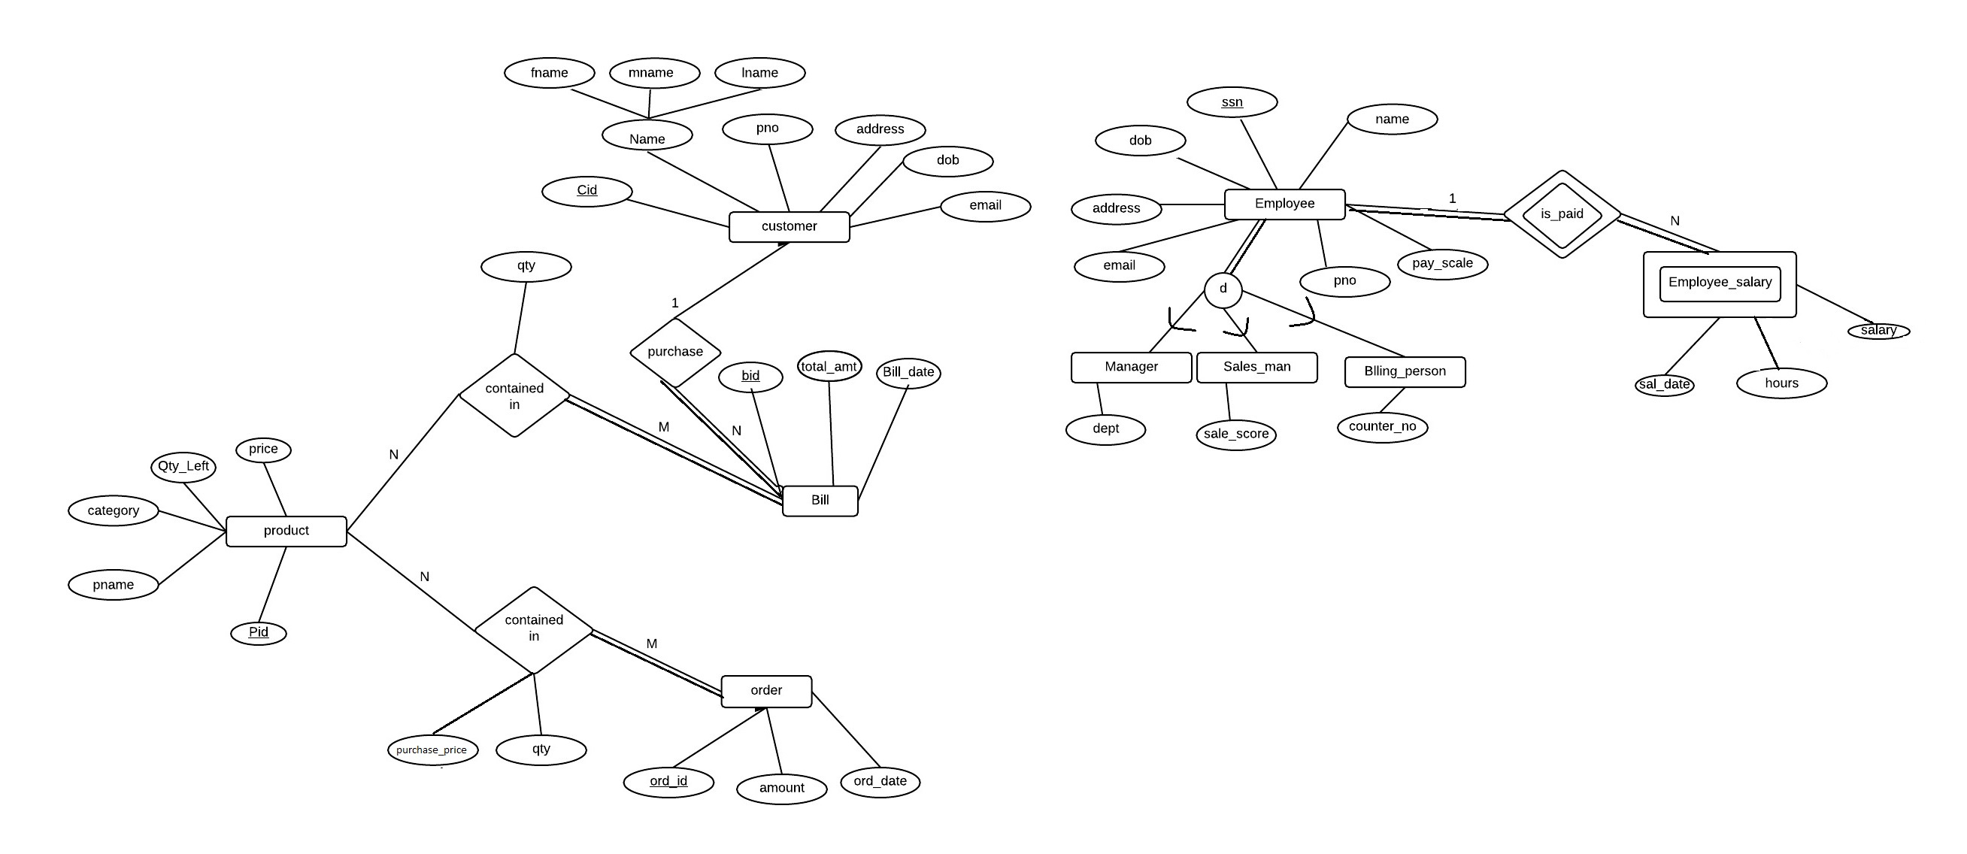
EER Diagram

Slide 4
ER diagram
The various entities present in the ER diagram are:
Customer
Employee – Manager, Sales_man, Billing_person
Product
Bills
Orders
Employee salary
Accounts

Slide 5
ER diagram description
Customer information is store in the customer table.
Employee are further specialized into 3 types – Manager, Sales_man, billing_person.
Products gives the description of various products including the quantity left etc.
The purchase made by the customer is stored in the Bills.
Similarly Orders is used to store the purchases made by the furniture store from the manufactures.
The information of hours worked of each employee and the salaries paid to him are stored in Employee_salary.

Slide 6






Relational Schema
Primary key: ssn
Foreign Key: none
Primary key: cid
Foreign Key: none
Primary key: ssn
Foreign Key: ssn -> employee(ssn)
Primary key: ssn
Foreign Key: ssn -> employee(ssn)
Primary key: pid
Foreign Key: none
Primary key: ssn
Foreign Key: ssn -> employee(ssn)

Slide 7



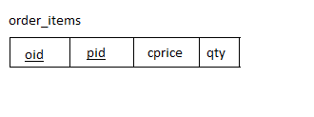

Relational Schema
primary key: ord_id
Foreign key: acc_id -> accounts(acc_id)
Primary key: bid
Foreign key: cid -> customer(cid)
Foreign key: acc_id -> accounts(acc_id)
Primary key: (ssn, sal_date)
Primary key: (oid, pid)
Foreign key: o_id -> orders(ord_id)
Foreign_key: pid -> product(pid)
Primary key: (bid, pid)
Foreign key: bid -> bills(bid)
Foreign key: pid -> product(pid)

Slide 8
PL/SQL
Trigger for updating the bills and reducing the stock:
create or replace trigger bill_items_insert
AFTER insert on bill_items for each row
DECLARE
x bills.total_amt%type;
y product.qty_left%type;
z product.price%type;
begin
Select total_amt into x from bills where bid=:new.bid;
Select price into z from product where pid=:new.pid;
x:=x+(:new.qty*z);
Select qty_left into y from product where pid=:new.pid;
y:=y-:new.qty; update bills set total_amt=x where bid=:new.bid;
update product set qty_left=y where pid=:new.pid; end;

Slide 9
PL/SQL
Trigger for updating orders and increasing stock when an order item is added:
create or replace trigger order_items_insert
AFTER insert on order_items
for each row
DECLARE
x orders.amount%type;
y PRODUCT.QTY_LEFT%type;
z product.price%type;
begin
Select amount into x from orders where oid=:new.oid; (cont..)

Slide 10
PL/SQL
Select price into z from product where pid=:new.pid;
x:=x+(z*:new.qty);
z:=:new.purchase_price*(1.1);
Select qty_left into y from product where pid=:new.pid;
y:=y+:new.qty;
update orders set amount=x where oid=:new.oid;
update product set qty_left=y where pid=:new.pid;
update product set price=z where pid=:new.pid;
end;

Slide 11
This procedure is used to check If we have profit or loss when a certain date is given
PL/SQL
create or replace procedure checkProfitorLoss(date1 IN date,date2 IN date) AS
thisord orders%ROWTYPE;
ordsum orders.amount%type;
thisbill bills%ROWTYPE;
billsum bills.total_amt%type;
thissal employee_salary%ROWTYPE;
salsum employee_salary.salary%type;
finalsum employee_salary.salary%type;
CURSOR Allord IS
SELECT * FROM orders where ord_date between (date1-1) and (date2+1);
CURSOR Allbill IS (cont..)

Slide 12
PL/SQL
SELECT * FROM bills where bill_date between (date1-1) and (date2+1);
CURSOR Allsal IS
SELECT * FROM employee_salary where sal_date between (date1-1) and (date2+1);
BEGIN
ordsum:=0;
billsum:=0;
salsum:=0;
OPEN Allord;
Open Allbill;
Open allsal;
LOOP
FETCH Allord INTO thisord;
EXIT WHEN (Allord%NOTFOUND);
ordsum:=ordsum+thisord.amount;
END LOOP;

Slide 13
PL/SQL
LOOP
FETCH Allbill INTO thisbill;
EXIT WHEN (Allbill%NOTFOUND);
billsum:=billsum+thisbill.total_amt;
END LOOP;
LOOP
FETCH Allsal INTO thissal;
EXIT WHEN (Allsal%NOTFOUND);
salsum:=salsum+thissal.salary;
END LOOP;

Slide 14
PL/SQL
salsum:=salsum*(-1);
ordsum:=ordsum*(-1);
finalsum:=salsum+ordsum+billsum;
IF finalsum < 0 THEN
dbms_output.put_line('There was a loss in this period of amount:'||finalsum);
ElSIF finalsum > 0 THEN
dbms_output.put_line('There was a profit in this period of amount:'||finalsum);
ELSE
dbms_output.put_line('There was no profit or loss in this period');
END IF;

Slide 15
PL/SQL
CLOSE Allord;
CLOSE Allsal;
CLOSE Allbill;
END;
set serveroutput on;
BEGIN
dbms_output.put_line('The details of profit or loss :');
CHECKPROFITORLOSS('01-dec-15','10-dec-15');
END;
.
RUN;

